Slide 1
Rare and less common cancers

Slide 2
Areas to cover
What do we mean by rare/less-common?
What are the differences in data, compared with “common”?
What are the data-related difficulties?

Slide 3
“Rare and less common” – not that rare?
47% of diagnoses are for rare and less common cancers
55% of cancer deaths are from rare and less common cancers
(Source Cancer52)
Notes:
Source: Cancer52 website

Slide 4
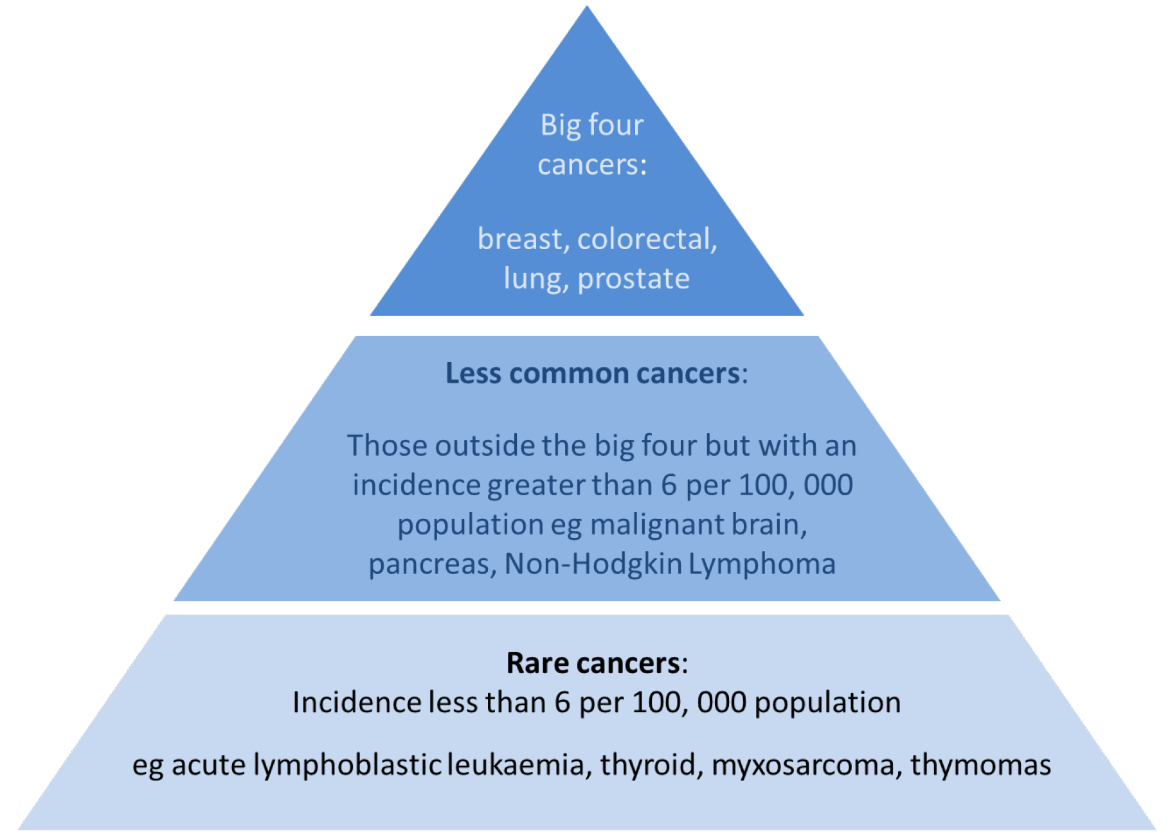
Notes:
Source: PHE/NCIN/C52 publication
http://www.ncin.org.uk/view?rid=2970

Slide 5
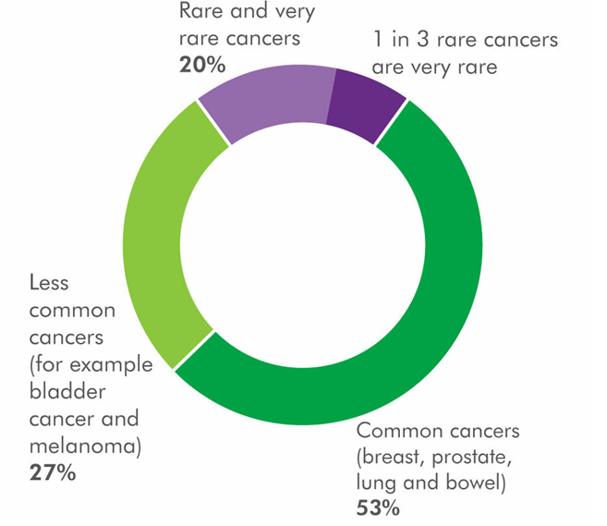
Notes:
Source: Macmillan at https://www.macmillan.org.uk/cancer-information-and-support/rare-cancers

Slide 6
Data challenges
Rare/less common cancers often need more granular coding
“bucket codes” were unhelpful
As the numbers are smaller, so statistical “confidence” is less precise
Wide confidence intervals mean conclusions are difficult
The published data has improved over recent years
Data quality is even more important for rare/less-common cancers

Slide 7
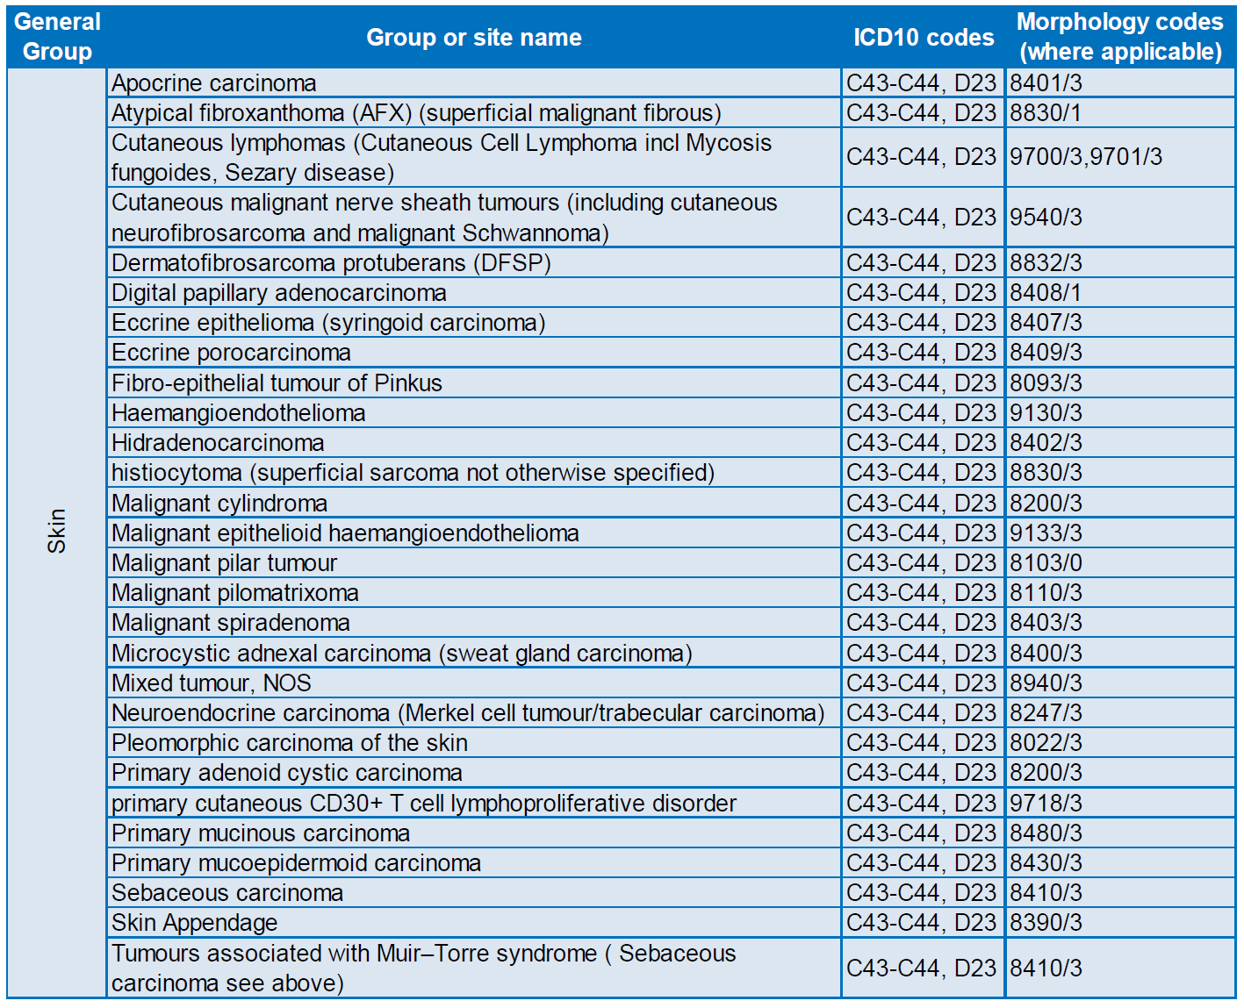
An example of the granularity of coding use, in this case for skin cancer

Slide 8
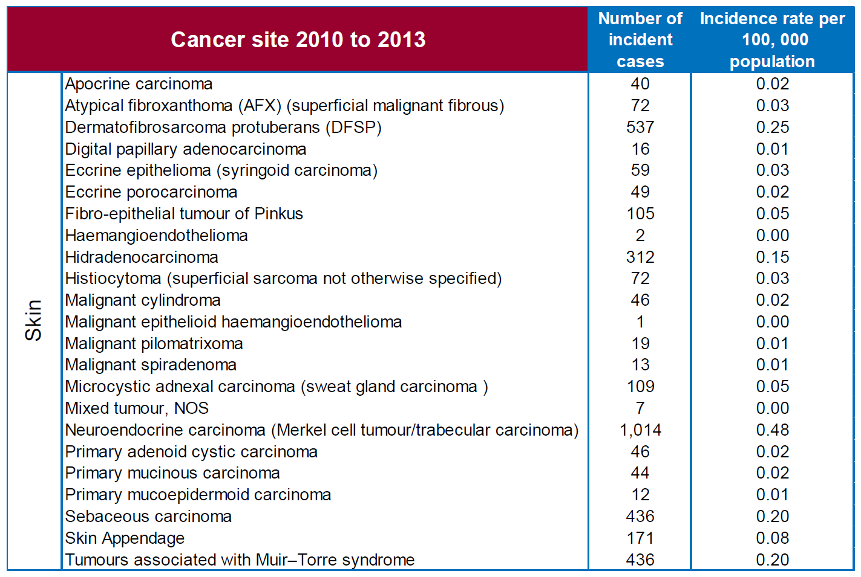
Just an example – these data are quite old, but were easy to find
Notes:
Source: PHE/NCIN/C52 publication
http://www.ncin.org.uk/view?rid=2970

Slide 9
With small numbers, producing analysis and statistics is difficult, but not impossible

Slide 10
Broad disclosure controls
“Data/information has to be released at a high enough level of aggregation to prevent others from recognising a particular individual”
Some ways round this:
“over the ten year period there were on average 1.2 cases per year”
Combining categories in which small number counts appear (e.g. age groups, time periods, areas)
Suppression of cells with small numbers
Nice examples in appendices at Public Health Wales site.
Notes:
https://phw.nhs.wales/about-us/policies-and-procedures/policies-and-procedures-documents/information-governance-information-management-and-technology-policies/small-numbers-publishing-guidance/

Slide 11
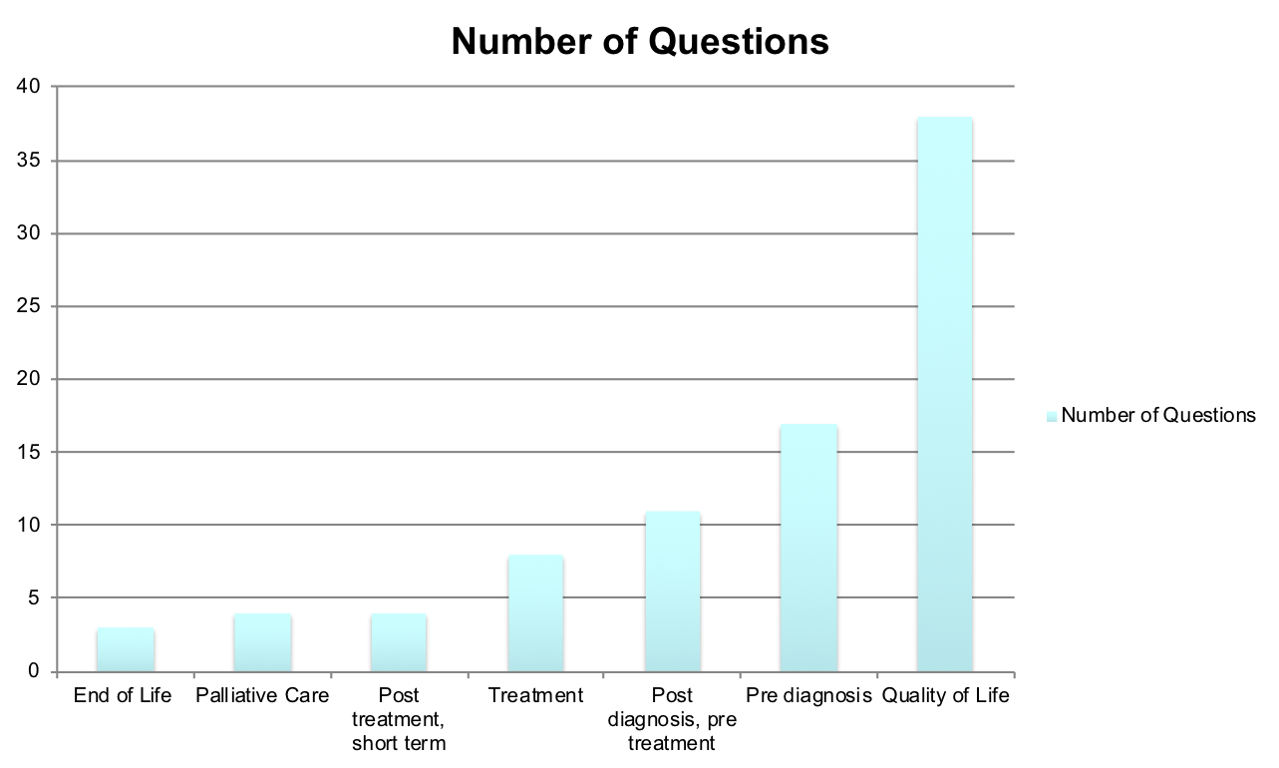
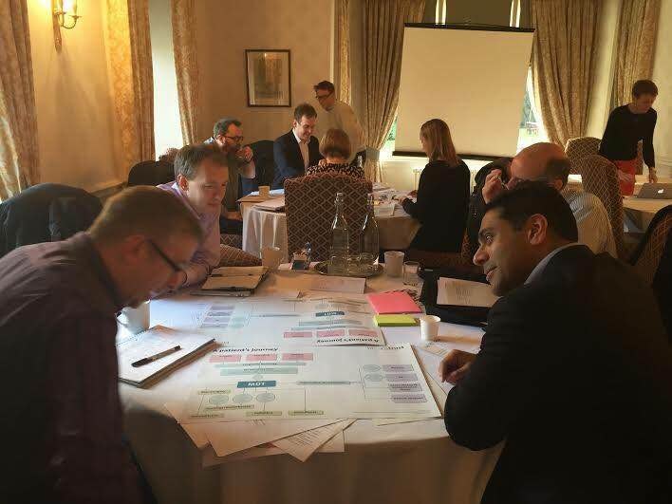
How one charity approached this…

Slide 12
They agreed a standard ‘slicing’ of the cancer data
Produce all PHE analysis to this slicing
Aiming to get about 100 people in every slice at least

Slide 13
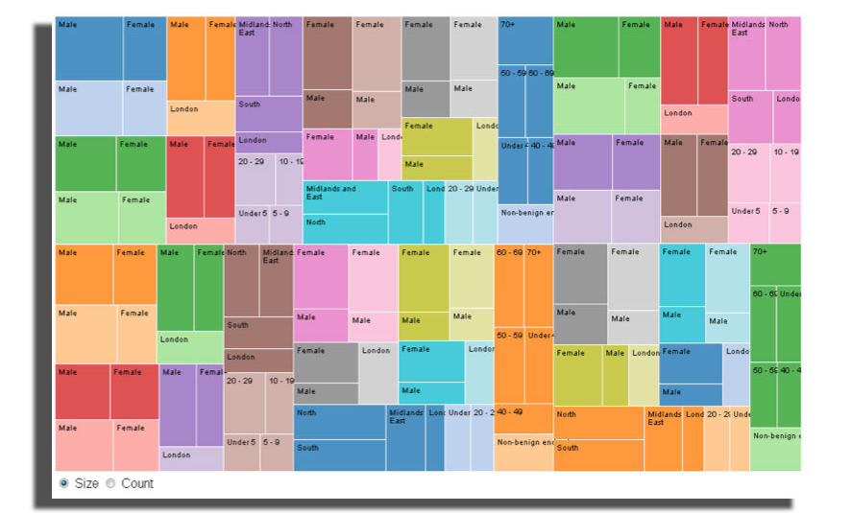

Slide 14
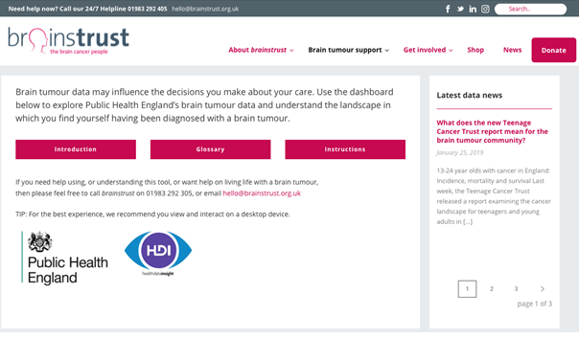
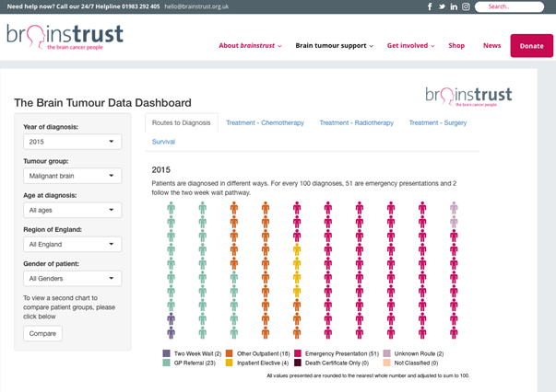

Slide 15
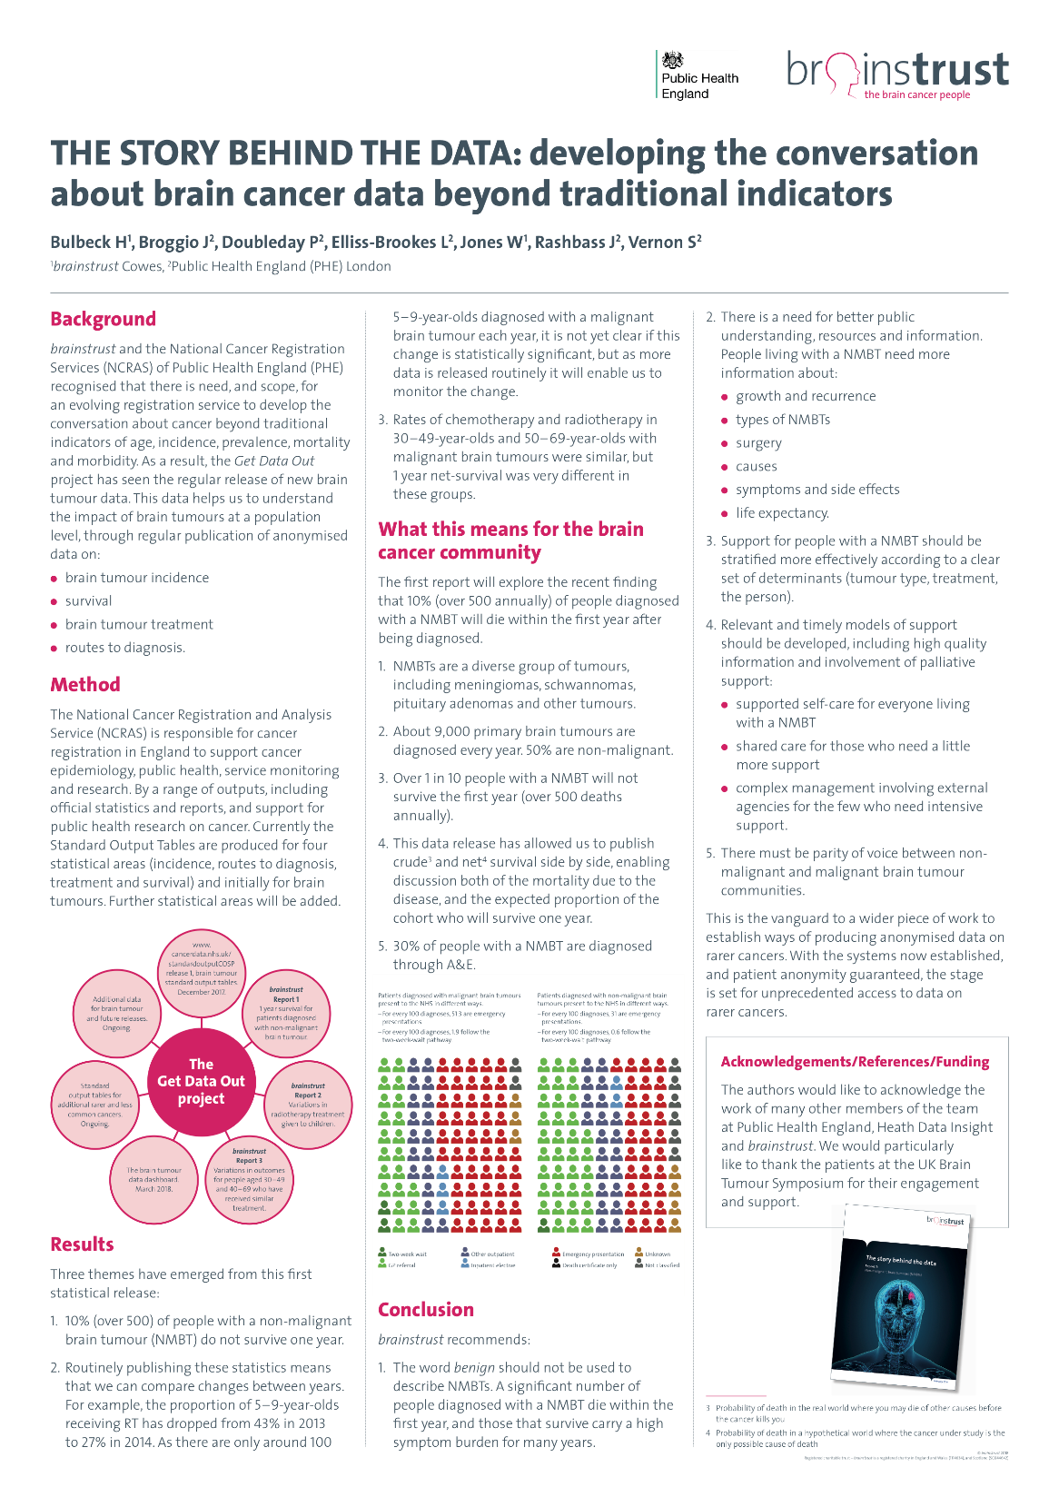
About 9,000 primary brain tumours are diagnosed every year. 50% are non-malignant
30% of people with a non-malignant brain tumour are diagnosed through A&E
10% (over 500 annually) of people diagnosed
with a non-malignant brain tumour will die a year of diagnosis
“This data release has allowed us to publish crude and net survival side by side, enabling discussion both of the mortality due to the disease, and the expected proportion of the cohort who will survive one year.”
With thanks to Will Jones, CEO, brainstrust

Slide 16
Take away points
Collectively, rare/less-common cancers are not rare
Rare/less-common cancers need rigorous coding, as poor data quality will affect analysis/outputs for rare/less-common cancers more than common cancers
Small numbers are difficult to analyse, but not impossible
Detailed analysis is helped with charity/patient support, engagement and inclusion

Slide 17
DATA-CAN PPIE Drop-in session “Rare and Less-Common Cancers”

